Slide 1
Next Generation Sequencing platforms
Kelvin Muteru, BSc
Bioinformatics Approaches for Next Generation Sequencing Analysis Workshop
30th November – 5th December 2015
International Centre for Insect Physiology and Ecology (icipe)
Nairobi, Kenya

Slide 2
Sequencing
Process of determining the precise order of nucleotides within a DNA molecule
NGS – modern sequencing techniques that allow faster and cheaper sequencing.

Slide 3
Overview of sequencing technologies
First Generation Sequencing
Sanger sequencing
Second Generation Sequencing
Illumina
454 or Pyrosequencing
Ion Torrent
ABI solid
Third Generation Sequencing
Pacific Bioscience
Oxford Nanopore

Slide 4
Sequencing technologies
First Generation Sequencing
Sanger sequencing
Second Generation Sequencing
Illumina
454 or Pyrosequencing
Ion Torrent
Third Generation Sequencing
Pacific Bioscience
Oxford Nano pore

Slide 5
Sanger sequencing
Also called chain termination method.
Developed by Fredrick Sanger in 1977.
Awarded Nobel prize in 1980.

Slide 6
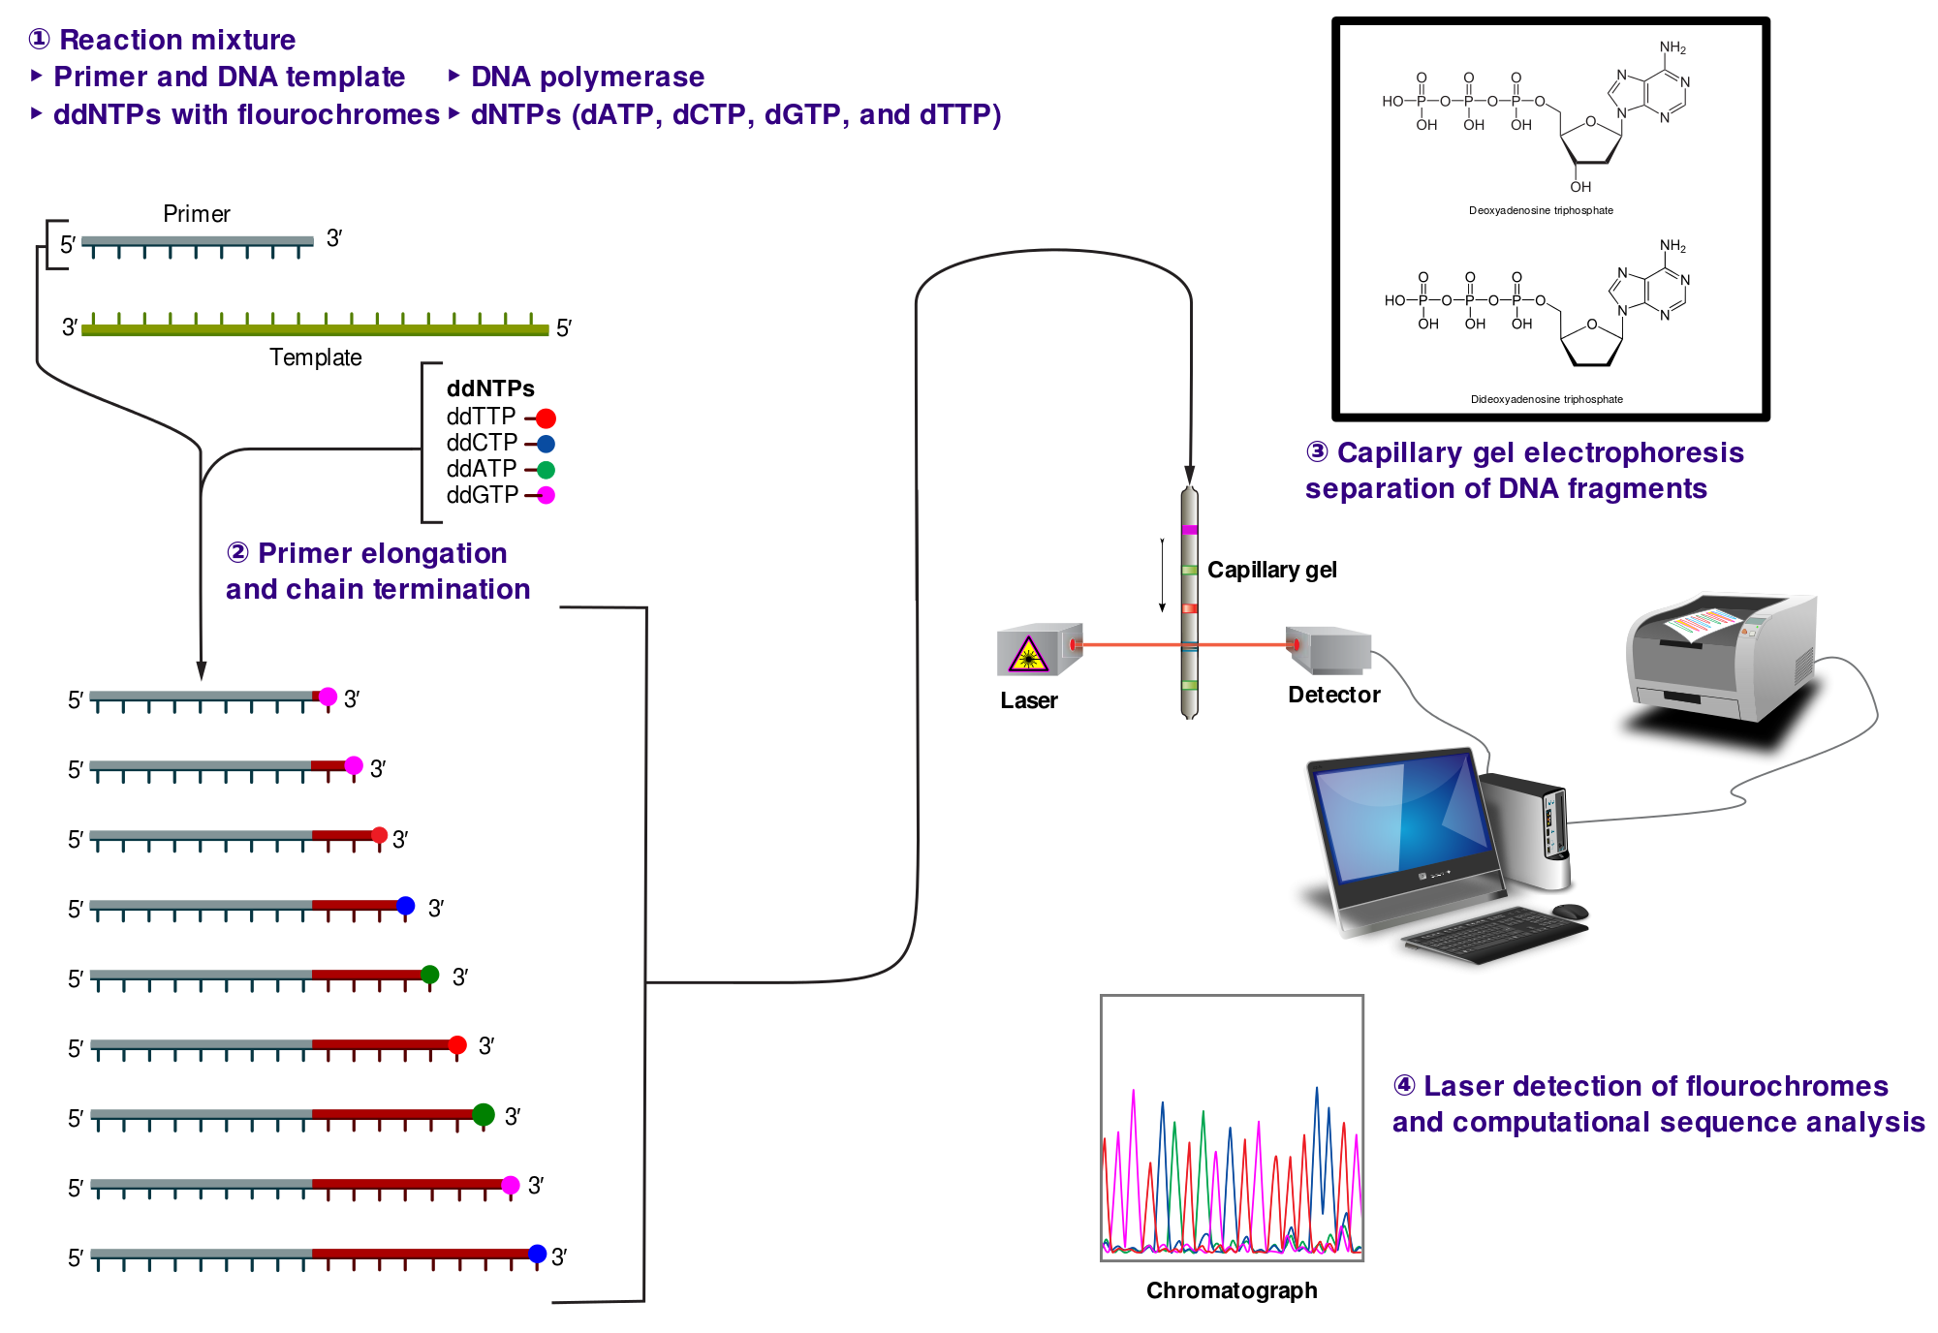

Slide 7
First genome sequenced: Haemophilus influenza (1995) – 1.8Mb of sequence in 7 months
Human genome (2001) – 3 Gb of data in 10 years. Cost USD 3 billion
Less error prone
Easy to analyze results
Poor quality in the first 15 - 40 bases due to primer binding.
Deteriorating quality of sequencing after 700 – 900 bases.

Slide 8
Sequencing technologies
First Generation Sequencing
Sanger sequencing
Second Generation Sequencing
Illumina
454 or Pyrosequencing
Ion Torrent
Third Generation Sequencing
Pacific Bioscience
Oxford Nano pore

Slide 9
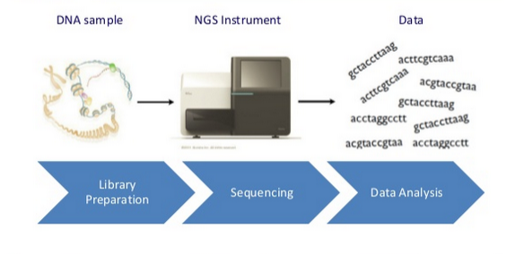

Slide 10
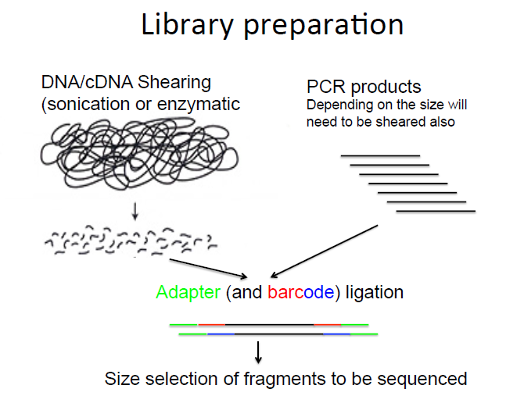

Slide 11
454 Pyrosequencing
Utilizes emulsion PCR
Instead of dyes, an enzyme is used to generate light for nucleotide detection.
Nucleotides are added sequentially

Slide 12
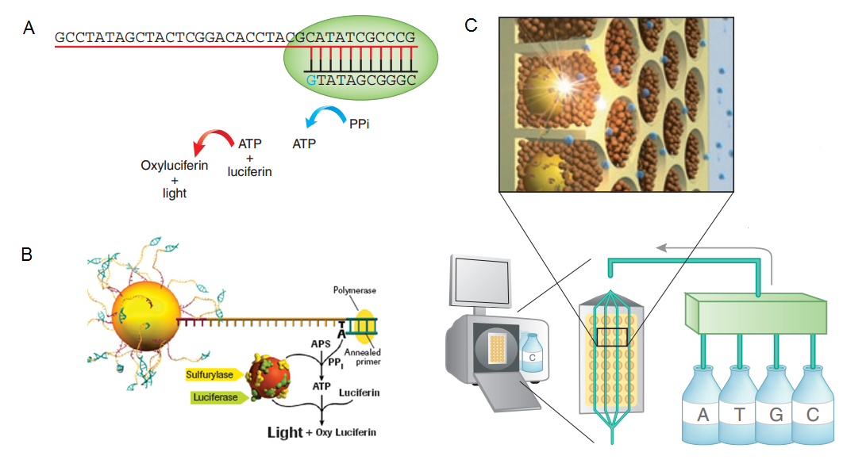

Slide 13
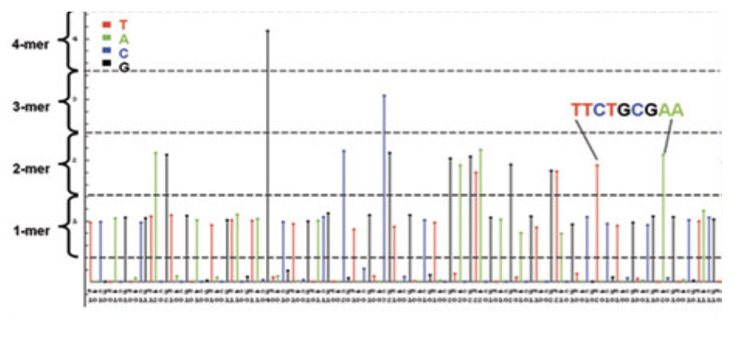
Signal strength proportional to the number of nucleotides incorporated

Slide 14
Longer reads
Higher throughput than Sanger sequencing – 20 million bases per 8 hours
10 USD per million bases
Relatively few reads
Not very accurate

Slide 15
Illumina Sequencing
Most widely adopted NGS platform
Sequencing by synthesis

Slide 16
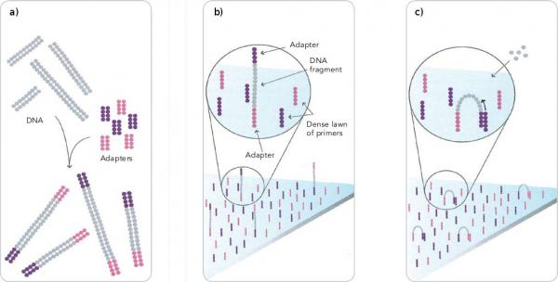
Fragment DNA & ligate adapters
Bind fragments to the flow cell surface
Add unlabeled dNTPs and enzyme to initiate bridge amplification

Slide 17
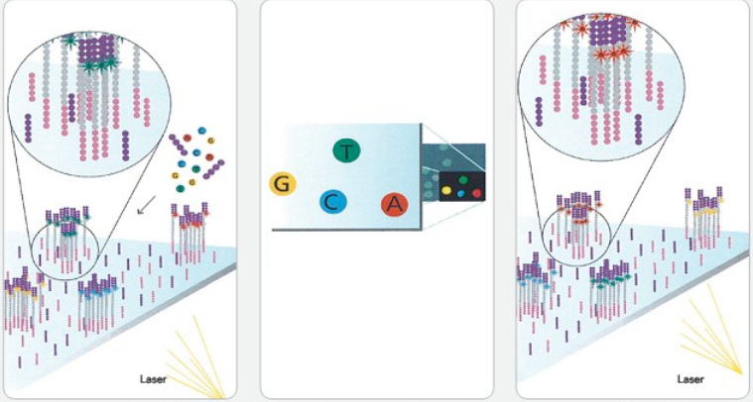
-Add four labelled reversible terminator bases, primers and DNA polymerase
- Laser excitation – emitted fluorescence captured and first base identified
- Sequencing cycles are repeated to determine each base at a time.

Slide 18
Very high throughput
Low price per base
Sequence quality decreases towards the end

Slide 19
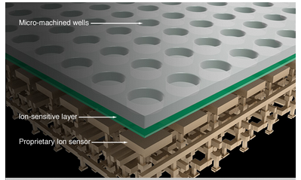
Ion torrent sequencing
Detection of H⁺ released during polymerization of DNA.
Sequencing by synthesis – complementary strand is built
Release H+ triggers sensor
Nucleotides flow sequentially

Slide 20
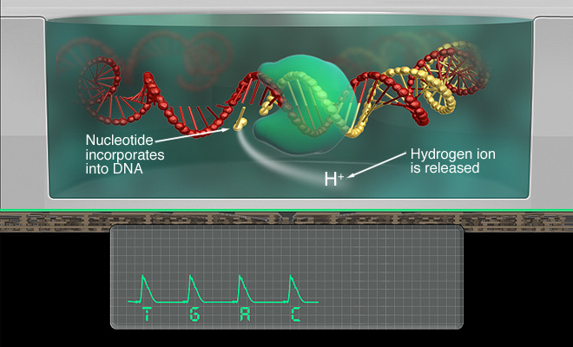

Slide 21
Its simple, fast and very accurate
Relatively cheap
Scalable – different chips can be used
Relatively high error rate

Slide 22
Sequencing technologies
First Generation Sequencing
Sanger sequencing
Second Generation Sequencing
Illumina
454 or Pyrosequencing
Ion Torrent
Third Generation Sequencing
Pacific Bioscience
Oxford Nano pore

Slide 23
Pacific Bioscience (PacBio)
Based on Single Molecule Real Time Sequencing (SMRT)
Zero Mode Waveguide (ZMW) is used.
Nucleotide incorporation and signal detection occurs continuously about 750nt/sec.

Slide 24
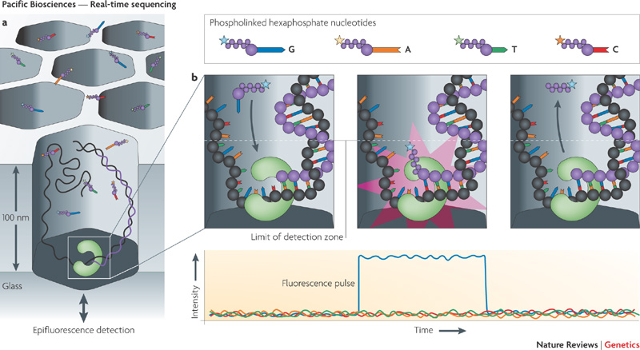

Slide 25
Long reads average 3kb
Total throughput is about 3Gb per day
Can detect DNA modifications like methylation
High error rate

Slide 26
Oxford nanopore
No amplification needed – minimum sample preparation.
Size of an USB-Key
Transfer directly the data into your computer
Currently we have the MinION portable sequencer
GridION and PromethION are under development

Slide 27
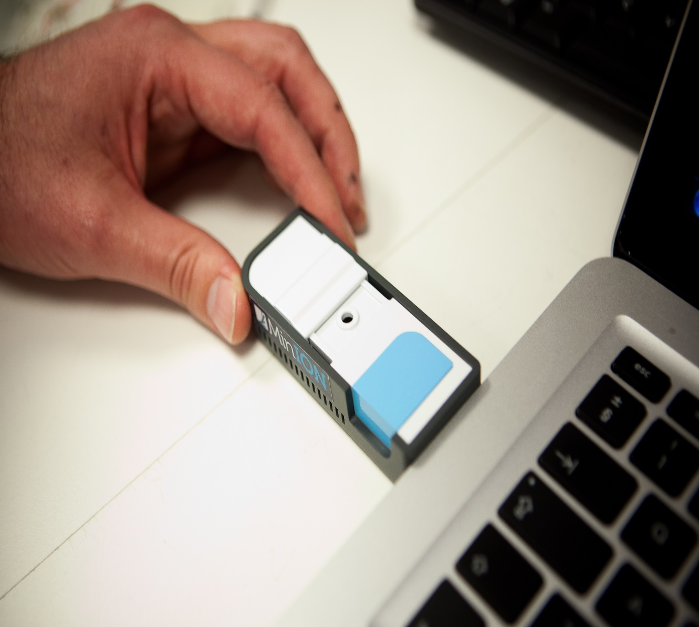
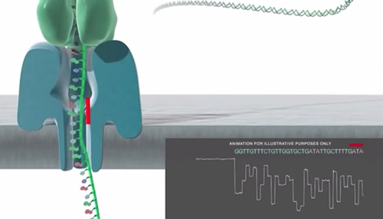
A
B

Slide 28
Very long reads 10kb – 50 kb
Very cheap
Minimum sample preparation and requirements
High error rate

Slide 29
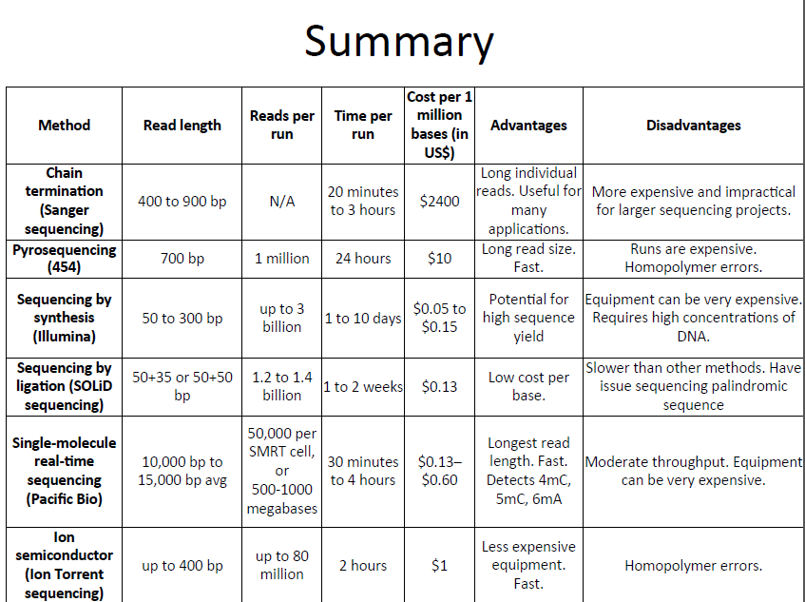

Slide 30
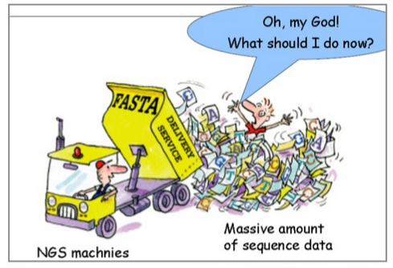
We are drowning in data but starving in information
That’s why you are here!!

Slide 31
Applications of NGS
DNA
De Novo sequencing
Amplicon Sequencing
SNP detection
Metagenomics
RNA
RNAseq
miRNAseq
DNA/Protein interactions
ChipSeq
Epigenetics
Methylation
Alternative splicing
Histone modification

Slide 32


